Slide 1
Enhancing Personalized E-Learning Platform (LearnPath+)
N.A.P.K.R Nishshanka, R.M.S.P. Abeykoon, K.A.K.N. Jayasinghe, and N.A.G.A. Nishshanka
Sri Lanka Institute of Information Technology
Date: September 2024

Slide 2
Introduction
• Online learning platforms play a critical role in education today.
• Most current platforms lack personalization and use static content.
• LearnPath+ is proposed to provide personalized learning using machine learning.

Slide 3
Objectives
1. Create personalized learning paths using machine learning.
1
2. Enhance user engagement, retention, and satisfaction.
2
3. Continuously test and adapt the system based on learner feedback.
3

Slide 4

Methodology (Overview)
Needs analysis using questionnaires, literature review, and educator consultations.
Design a user-oriented framework with machine learning, UX design, and modular CMS.
Develop algorithms using supervised, unsupervised, and reinforcement learning.
Implement the system and evaluate user satisfaction, knowledge gain, and engagement.

Slide 5

OVERALL RESEARCH PROBLEM
Lack of Personalization: E-learning platforms struggle to tailor personalized learning experiences to individual preferences and learning styles.
Generic Approaches: Current systems use content delivery methods that don't maximize user engagement or knowledge retention.
Limited Adaptability: Most platforms can't dynamically adjust to diverse learner needs, creating difficulties in accessing relevant materials.
Gap in Literature: There's a lack of research on developing adaptive machine learning models for customizing learning pathways in online education.
Notes:
Let's delve into the overall research problem. First, there's a significant lack of personalization across existing e-learning platforms. They struggle to deliver personalized learning experiences that fit individual preferences and learning styles. Current systems often rely on generic content delivery approaches that don't optimize user engagement or knowledge retention.
Additionally, many platforms have limited adaptability. This makes it challenging to dynamically adjust to individual learner needs, leaving many students struggling to find relevant content. Finally, there's a notable gap in the literature. There's a lack of research focused on straightforward adaptive machine learning models that can effectively customize learning pathways in online education. This gap is what our research aims to address.

Slide 6
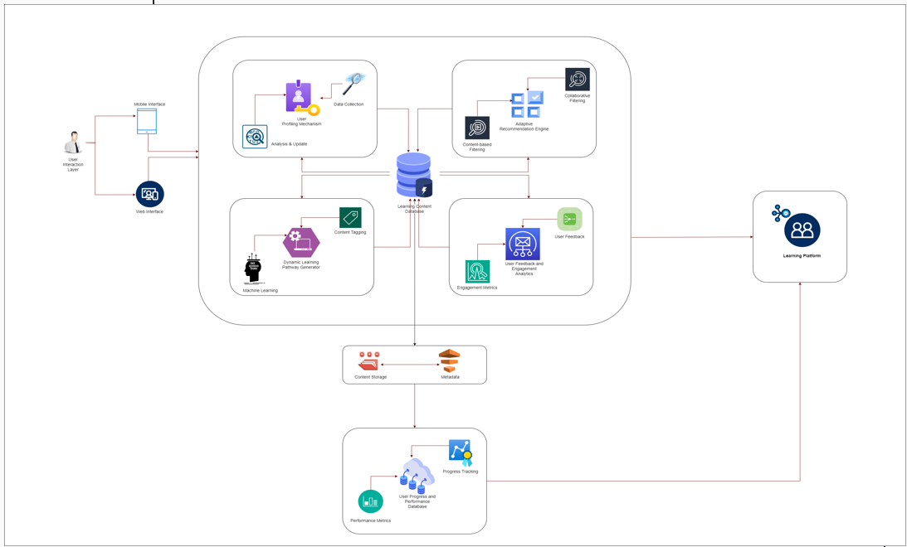
Overall System Diagram

Slide 7

IT21033032 | Nishshanka N.A.P.K.R component 01
Objective : Implementing Student Learning Profiling module for better user profile analysis.
Specialization: Information Technology
IT21033032
Nishshanka N.A.P.K.R | R24-112

Slide 8

Component 1: Student Learning Profiling Module
Purpose: Build user profiles based on learning preferences, past performance, and styles.
Uses questionnaires and initial performance data for profiling.
Dynamic profiling updates based on real-time data using Python and ML libraries.
Data stored in a MySQL database and updated weekly for accuracy improvement.
Example: Profiling accuracy improves from 75% in week 1 to 90% by week 3.

Slide 9

RESEARCH PROBLEM
How can user data, including learning preferences, past performance, and preferred learning styles, be effectively gathered and analyzed to create personalized profiles?
How do different factors within user profiles interact to influence the effectiveness of personalized learning experiences?
What are the privacy and ethical considerations associated with collecting and utilizing user data for personalized e-learning?
How to integrate OpenAi or GeminiAi for user profiling of LMS?

Slide 10
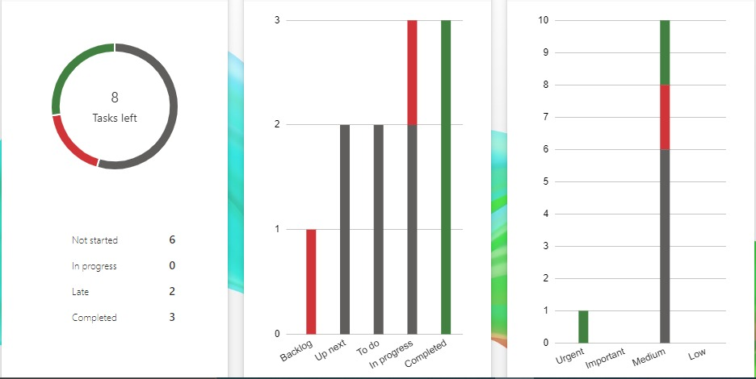
COMPLETED TASKS
Complete background research about other LMS platforms and their data usage.
Finalize the initial dataset which need to make the initial user profiling part.
Implement a sample python code for perform the initial user profiling (exam results-based part).
Identify and finalize the technology stack and backend configurations and database configurations for overall system.
Learn about the relate technologies (system engineering terms) for how to setup this kind of system in real world.
Partially implement a webpages related to the component.
Implementing a python-based backend module for evaluate the initial student data and give the initial user profiling.
Implementing a python-based backend module for evaluate the both of data initial and dynamic and give the weekly user profiling.
Implementing the MySQL database configuration related to the user profiling part.

Slide 11
Student Learning Profiling Module : Component Diagram

Slide 12
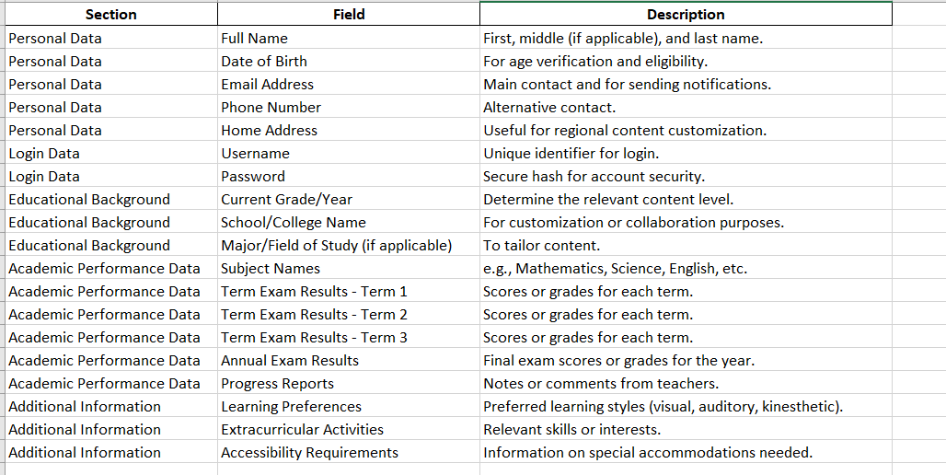
IMPLEMENTATION – PoC
Initial student dataset Finalized

Slide 13
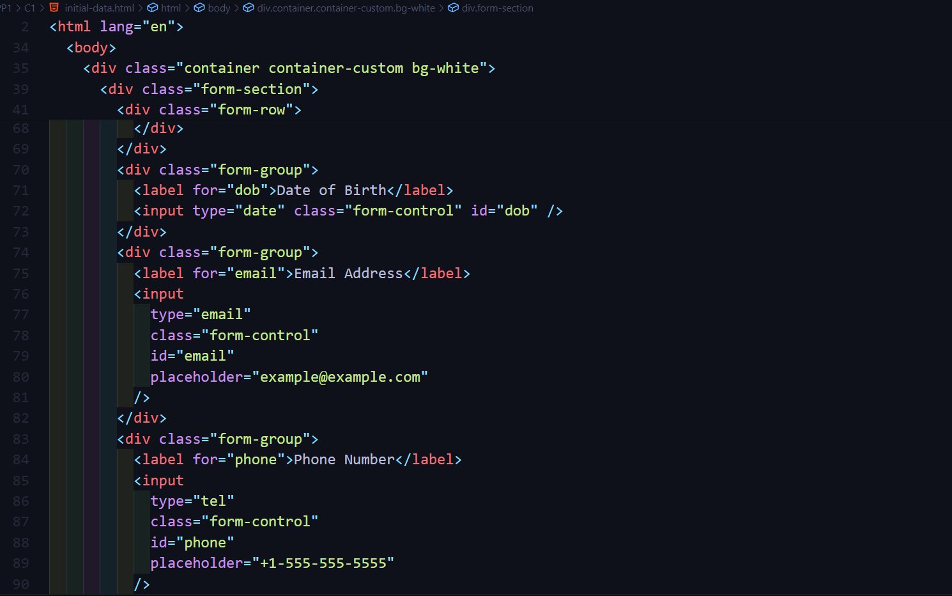
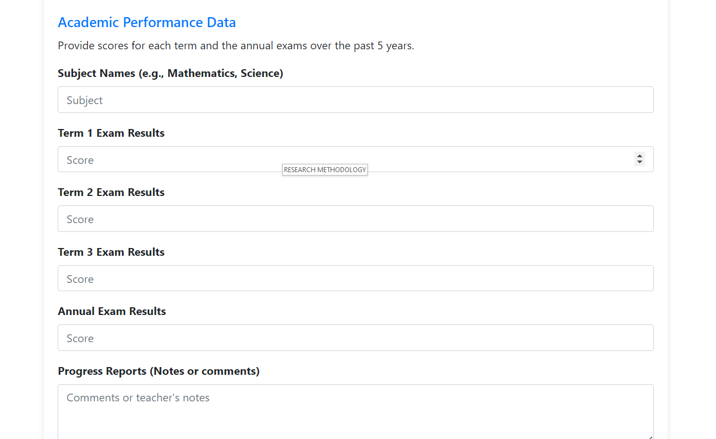
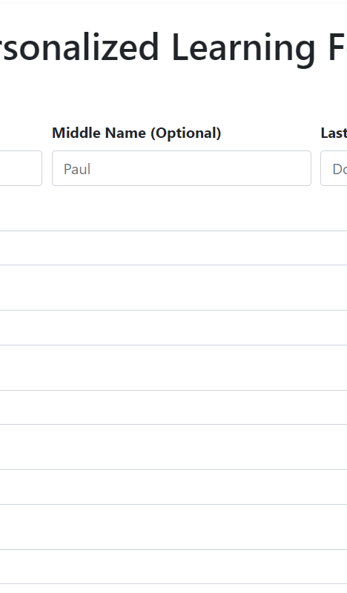
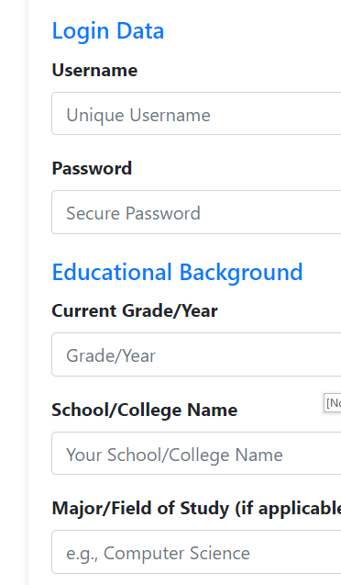
IMPLEMENTATION – PoC
Initial Data gathering form

Slide 14
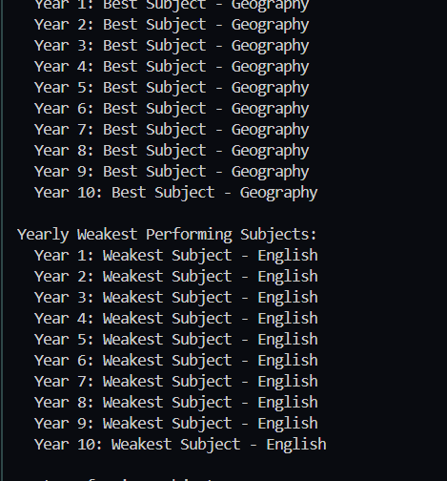
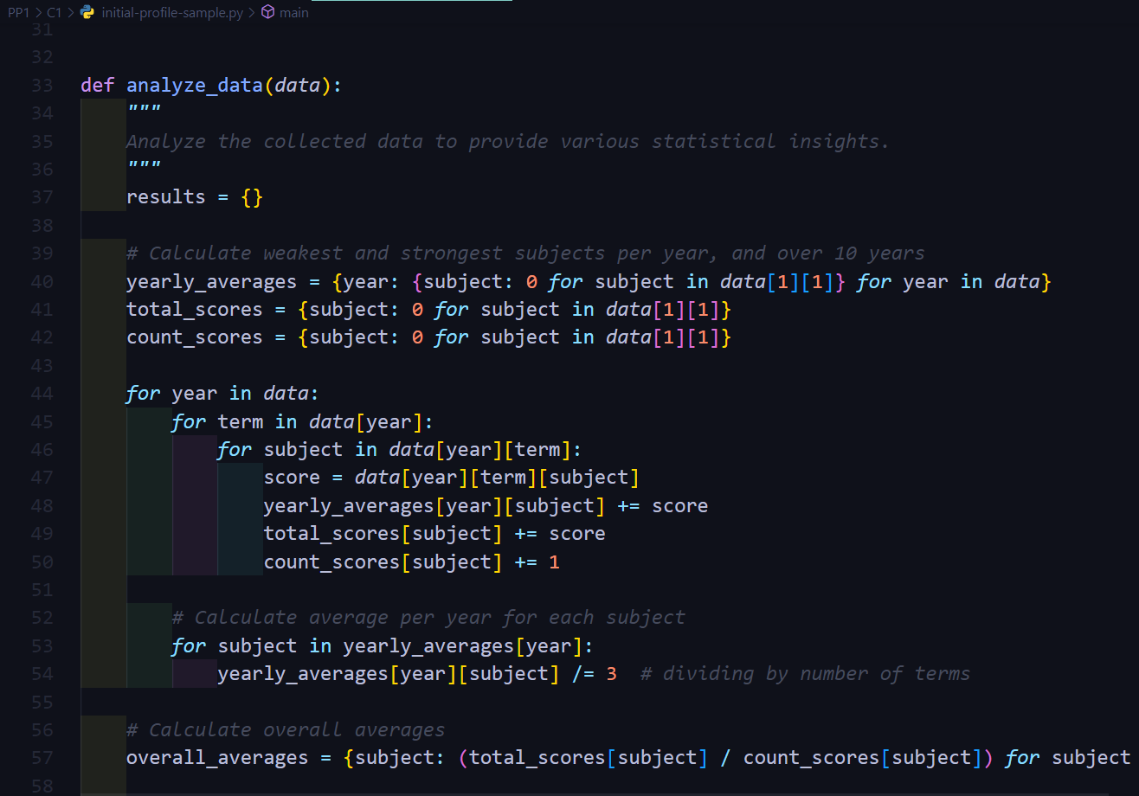
IMPLEMENTATION – PoC
Initial Data sample analysis python code

Slide 15
IT21021602 | Abeykoon R.M.S.P component 02
Objective : Implementing Adaptive Recommendation Engine for suggest learning resources and predict the student performance using AIML
Specialization: Information Technology
IT21021602
Abeykoon R.M.S.P | R24-112

Slide 16

Component 2: Adaptive Recommandation Engine
Purpose: Recommend learning resources and predict performance using AI/ML.
Analyzes past grades, current course enrollment, and preferences.
Outputs include personalized study plans and predictive performance scores.
High recommendation accuracy for high-performing students (92%) and mid-level students (85%).

Slide 17
RESEARCH PROBLEM
To what extent does the Adaptive Recommendation Engine improve the relevance and appropriateness of learning content recommendations compared to traditional e-learning systems?
What is the impact of real-time adjustments in recommendations on user engagement within the e-learning platform?
How is the implement AIML module for give prediction for future about the students' leering performance?
How does the Adaptive Recommendation Engine compare with traditional e-learning systems in terms of providing tailored learning experiences?

Slide 18

SPECIFIC AND SUB OBJECTIVES
Implement a python module for analysis the initial educational data of student and identify the weak to best scores.
Implement a python-based backend module for analysis the weekly interest of user about the subjects for setup the priority list of learning resource suggestion.
Develop a AIML model to predict the student performance if student work according to the suggested learning plan.
Implementing the MySQL database configuration related to the component.
Implementing the all-relevant frontend pages related to the component.

Slide 19
Adaptive Recommendation Engine : Component Diagram

Slide 20
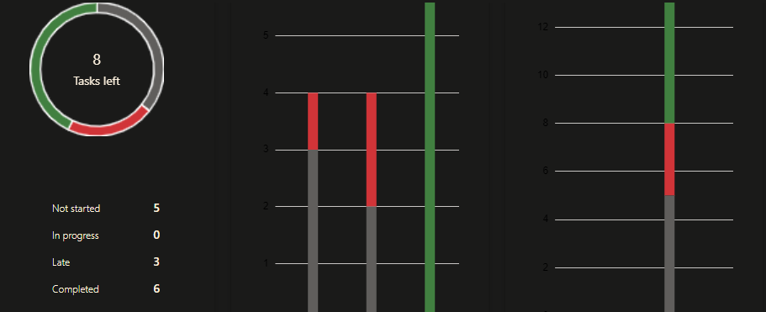
COMPLETED TASKS
Complete background research about other LMS platforms and their data usage.
Implement a simple python code for identify the weak subjects from initial user exam data.
Identify the scores types which need to process with AIML part to give performance prediction.
Research about AIML algorithms which can use to this AIML implementation.
Identify and finalize the technology stack and backend configurations and database configurations for overall system.
Learn about the relate technologies (system engineering terms) for how to setup this kind of system in real world.
Implementing a python-based backend module for evaluate the initial student data and give the initial user profiling.
Implementing a python-based backend module for evaluate the both of data initial and dynamic and give the weekly user profiling.
Implementing the MySQL database configuration related to the user profiling part.

Slide 21
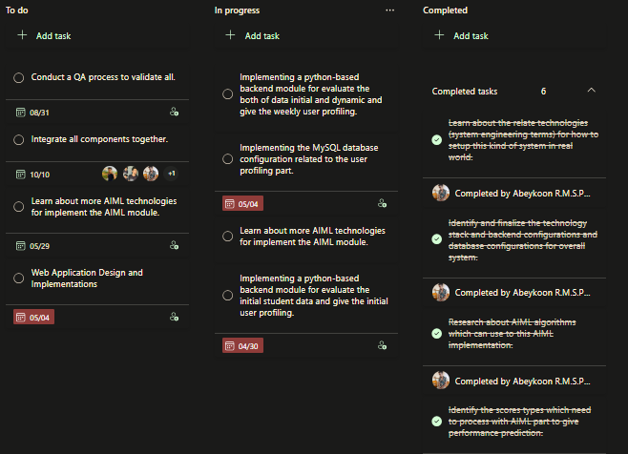
PROJECT PLANNING

Slide 22
METHODOLOGY – AIML Module
Score Processing with ML
1. Individual Subject Marks: Marks obtained by students in each subject.
2. Overall Average: Average marks of each student across all subjects.
3. Subject-wise Averages and Deviations: Average marks and standard deviations of each student in individual subjects.
4. Attendance: Attendance record of each student.
5. Study Hours: Time spent studying by each student.
6. Homework Completion Rate: Percentage of homework assignments completed by each student.
7. Test Scores: Scores obtained by students in standardized tests or assessments.
8. Participation in Extra-curricular Activities: Whether a student participates in sports, clubs, or other activities.
9. Parental Education Level: Education level attained by the student's parents, which can be indicative of socio-economic status.
10. Student Demographics: Gender, age, and other demographic information.
Notes:
Past data evaluate ….
New data evaluate – behavior
Plan –
AIML result – predict if he work according to our plan - results

Slide 23
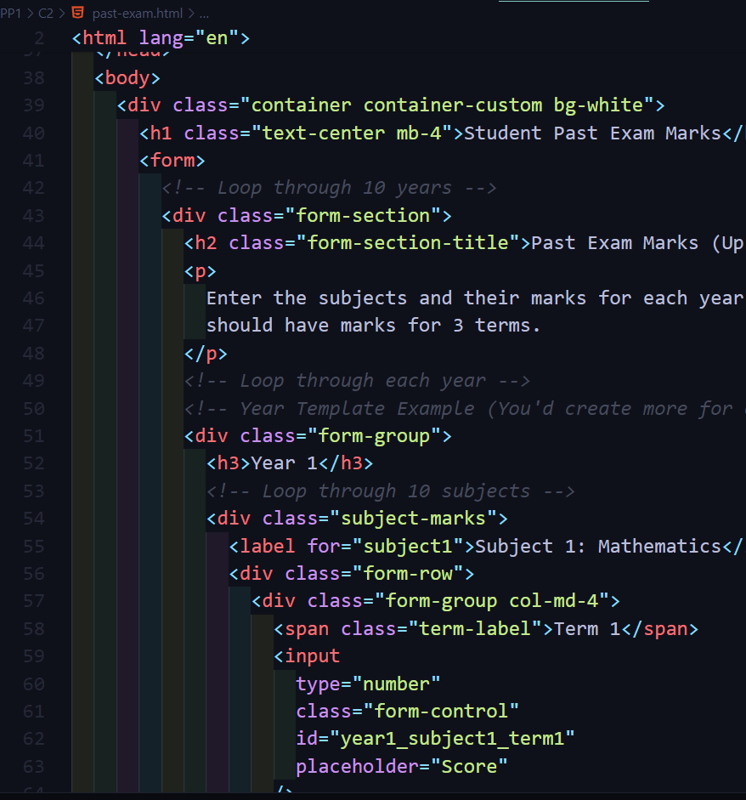
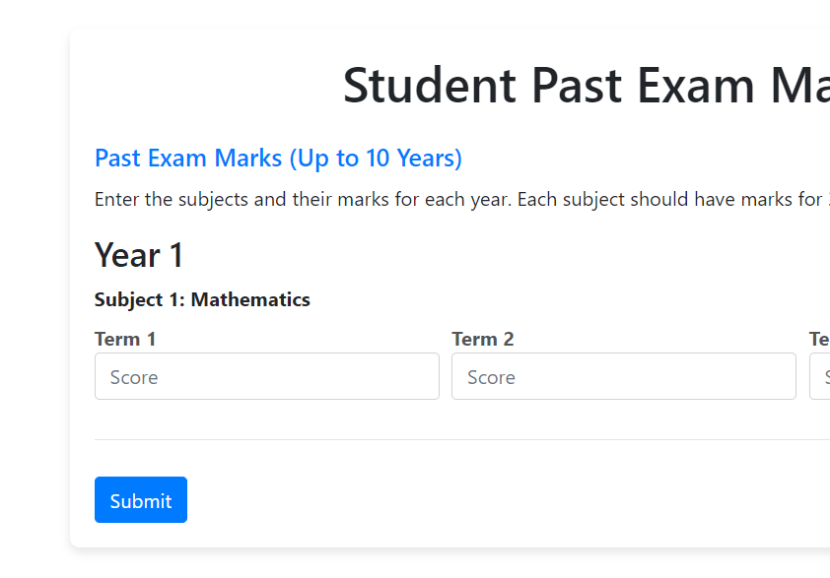
IMPLEMENTATION – PoC
Past Exam result gather form

Slide 24
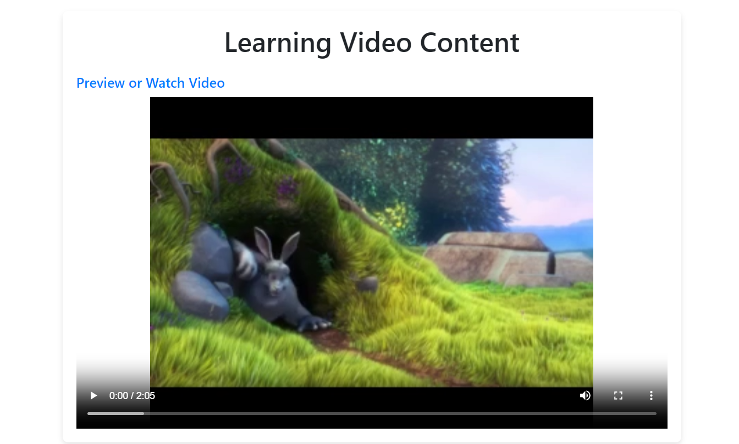
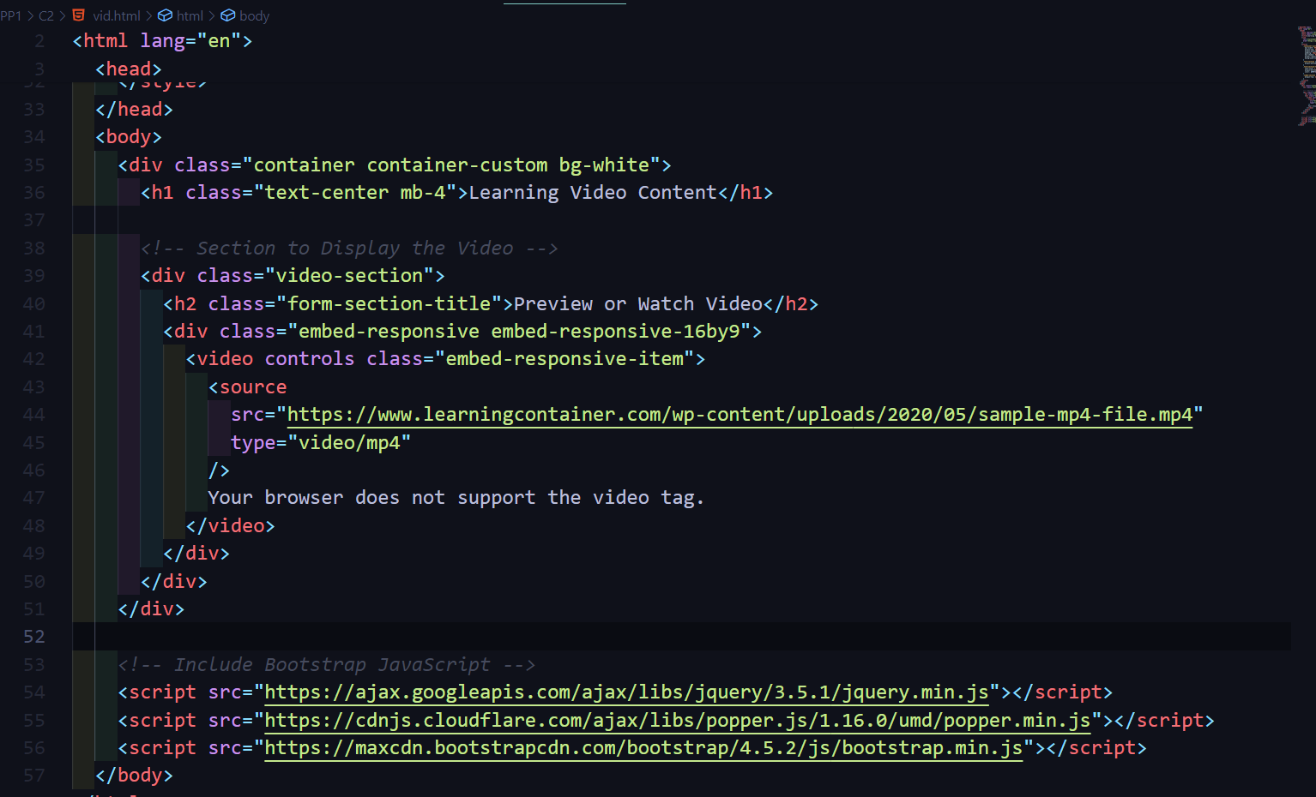
IMPLEMENTATION – PoC
Learn material showing page

Slide 25
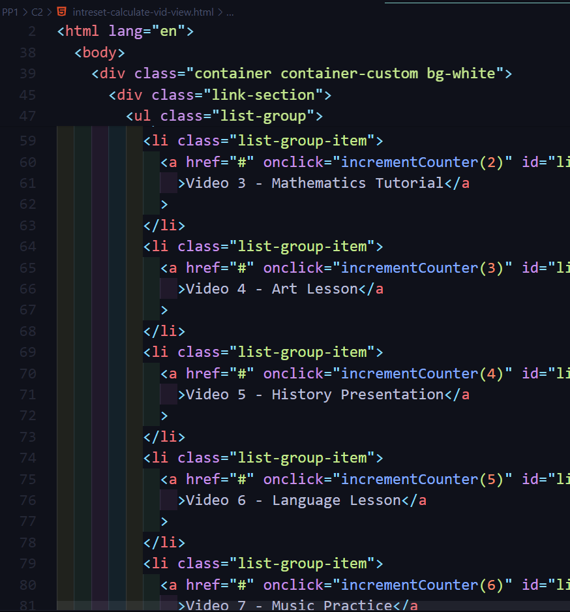
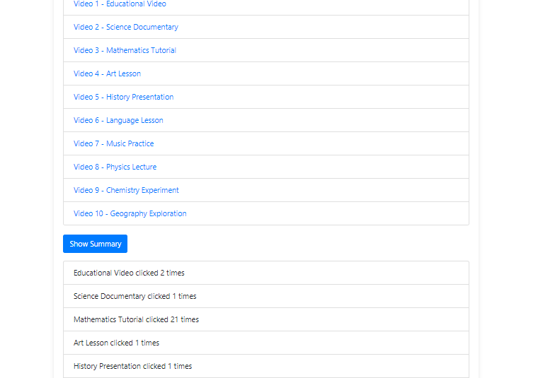
IMPLEMENTATION – PoC
User Interest analysis page (identify priority according to the access times of content)

Slide 26
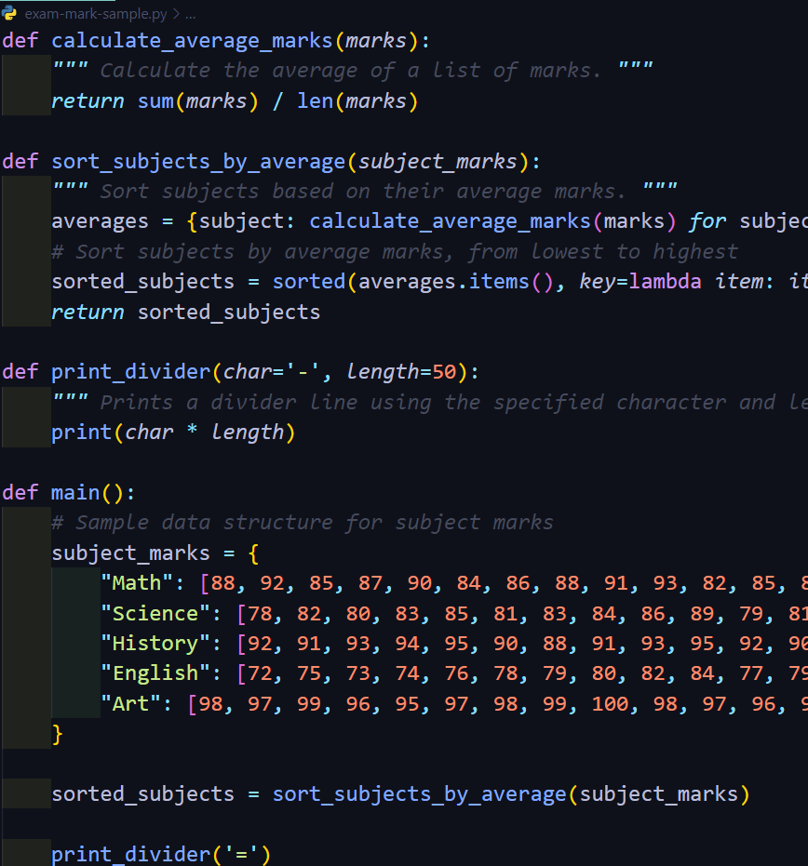
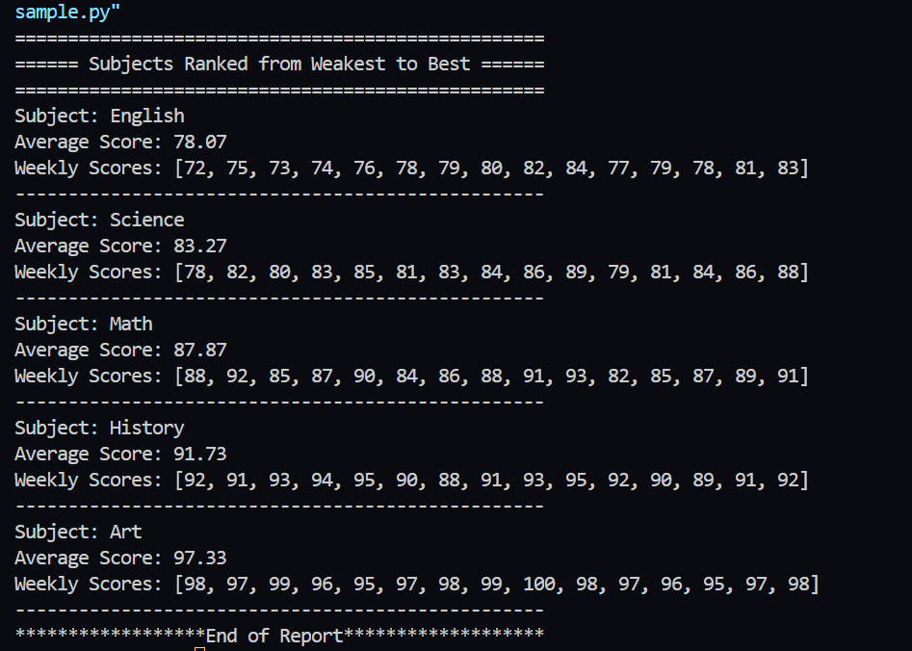
IMPLEMENTATION – PoC
Weak Subjects identification script from initial user data

Slide 27
IT21033806 | Jayasinghe K.A.K.N component 03
Objective : The Dynamic Learning Pathway Generator customizes learning experiences based on individual traits, optimizing efficiency and engagement through machine learning.
Specialization: Information Technology
IT21033806
Jayasinghe K.A.K.N | R24-112

Slide 28

Component 3: Dynamic Learning Pathway Generator
Purpose: Design personalized learning paths based on user profiles and goals.
Suggested content and quizzes tailored to proficiency levels and learning styles.
Real-time updates to pathways based on user feedback and engagement data.
Optimization improves quiz completion rate (from 65% to 78%) and time spent on materials.

Slide 29
RESEARCH PROBLEM
How to effectively tailor learning pathways to accommodate diverse individual characteristics, preferences, and goals?
How can learning pathways be optimized to maximize learning outcomes while minimizing time and effort?
How to develop a system that continuously adjusts learning pathways based on user feedback, performance, and evolving educational needs?
What strategies can be employed to enhance user motivation, engagement, and satisfaction with the learning process?
How to provide a diverse range of content formats and difficulty levels to promote a comprehensive and well-rounded learning experience?

Slide 30
SPECIFIC AND SUB OBJECTIVES
The Dynamic Learning Pathway Generator aims to profile users based on their learning styles, proficiency levels, preferences, and goals.
It recommends personalized learning materials, such as lectures and quizzes, tailored to individual preferences and proficiency levels.
Efficiency is optimized by analysing user behaviour to minimize redundancy and maximize knowledge retention in content sequencing.
Adaptation mechanisms continuously monitor user feedback to adjust learning pathways in real-time, ensuring relevance and effectiveness.
Motivation and engagement strategies, like goal-setting and interactive features, are integrated to enhance user engagement throughout the learning process.

Slide 31
Dynamic Learning Pathway Generator : Component Diagram

Slide 32
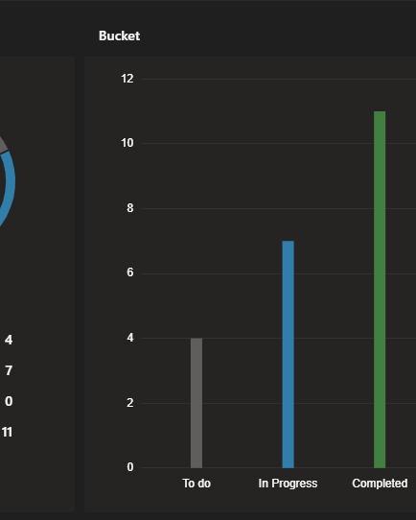
COMPLETED TASKS
Conducted comprehensive research on existing Learning Management System (LMS) platforms and their data usage.
Explored various AI and machine learning algorithms suitable for implementing the Dynamic Learning Pathway Generator.
Curated and finalized a dataset comprising 5000 rows for identifying user learning styles.
Developed and implemented a model for the Dynamic Learning Pathway Generator, integrated with an API for seamless interaction.
Identified suitable technology stack, backend configurations, and database configurations for the system.
Acquired knowledge about related technologies and best practices for real-world implementation of educational technology systems.
Conducting usability testing to gather feedback on the prototype of the Dynamic Learning Pathway Generator.
Refining the user interface design based on feedback and usability testing results.
Implementing the MySQL database configuration related to the Dynamic Learning pathway Generator part.

Slide 33
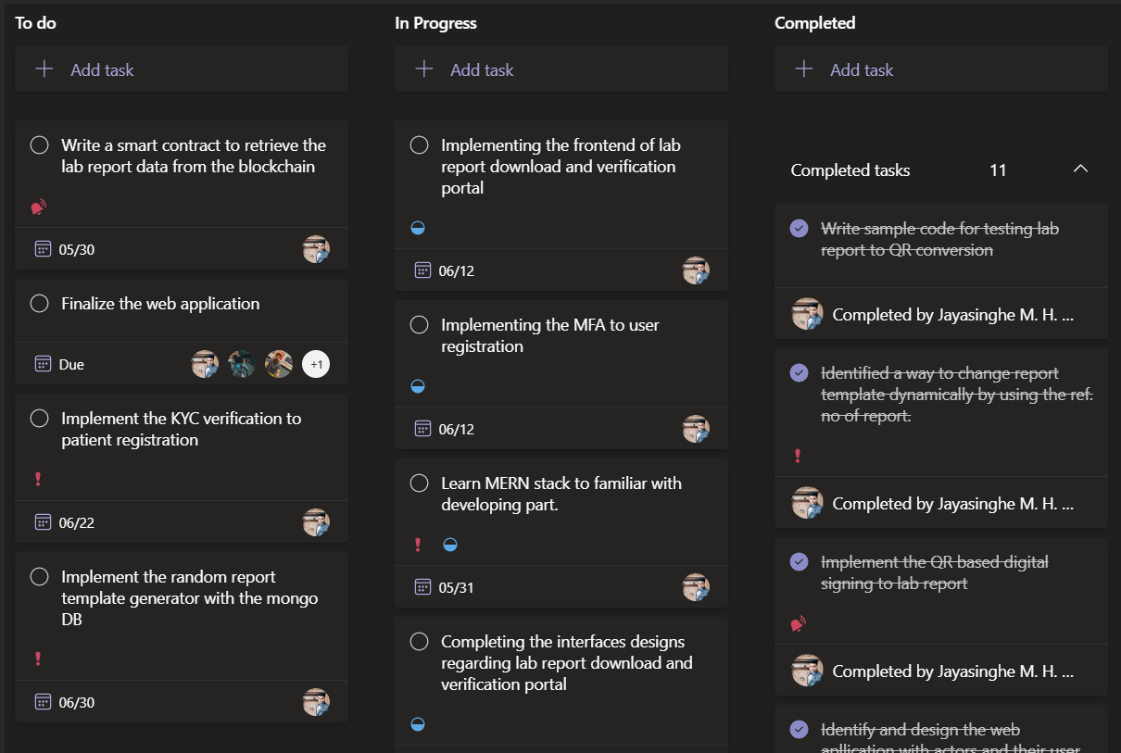
PROJECT PLANNING

Slide 34
METHODOLOGY – AIML Module
Score Processing with ML
1. Data Collection: Gather a dataset with examples of individuals and their corresponding learning styles along with the factors influencing those styles.
2. Data Preprocessing: Preprocess the data by encoding categorical variables, handling missing values, and scaling numerical features if necessary.
3. Feature Engineering: Extract relevant features from the data that could influence learning style preferences. This may involve transforming or combining existing features.
4. Model Selection: Choose an appropriate machine learning model for classification. Since you have categorical output (learning style), you might consider models like Decision Trees, Random Forests, or even a Neural Network.
5. Training: Split your data into training and testing sets. Train the selected model on the training data.
6. Evaluation: Evaluate the trained model using appropriate metrics such as accuracy, precision, recall, or F1-score on the testing data.
7. Hyperparameter Tuning: Fine-tune the model hyperparameters to improve performance, if necessary.
8. Prediction: Once you have a trained model, you can use it to predict the learning style for new individuals based on their input features.
Notes:
Past data evaluate ….
New data evaluate – behavior
Plan –
AIML result – predict if he work according to our plan - results

Slide 35
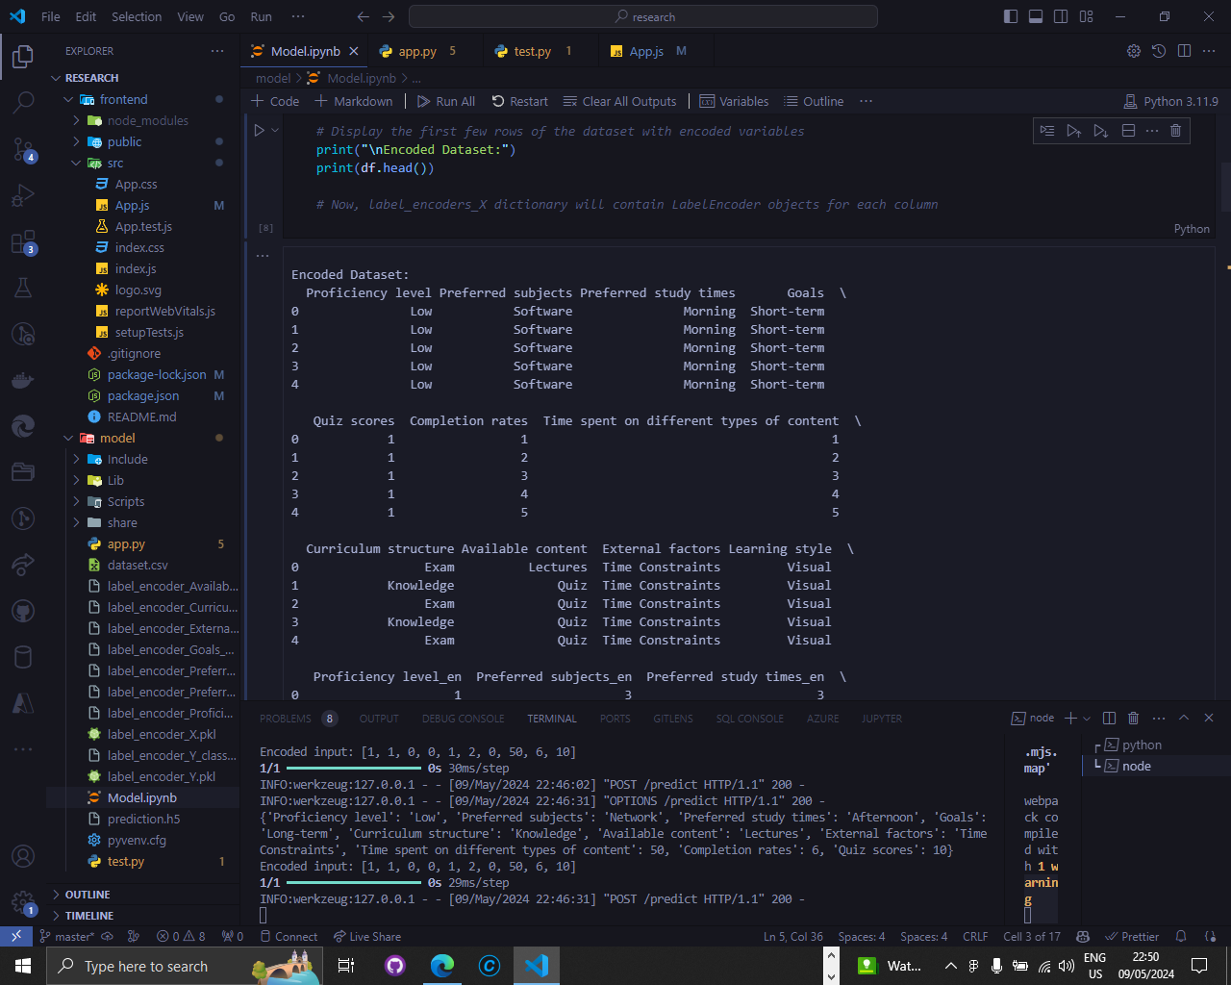
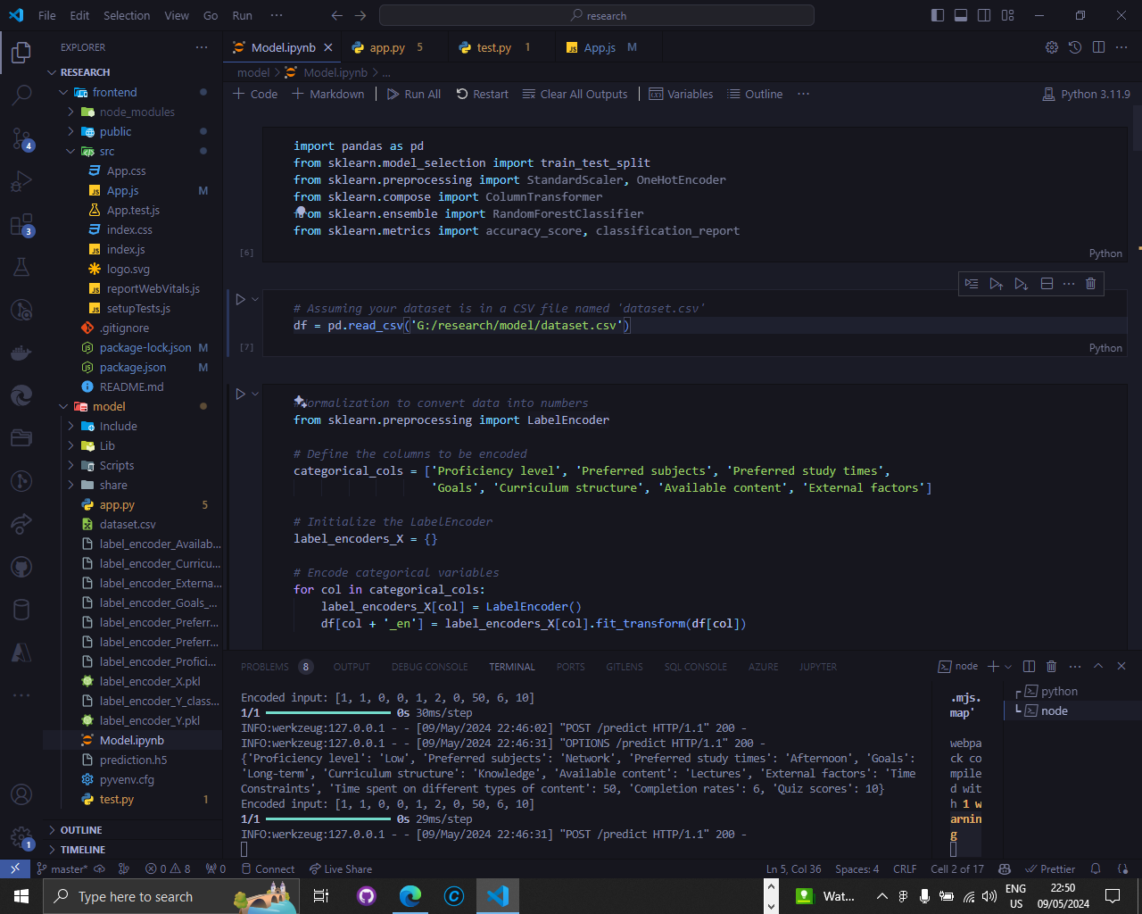
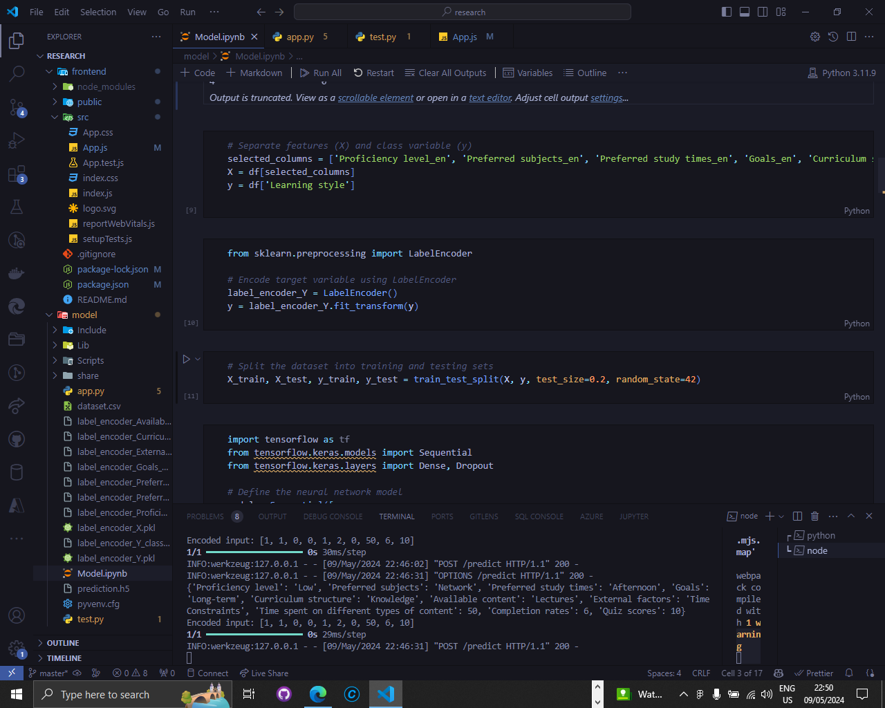
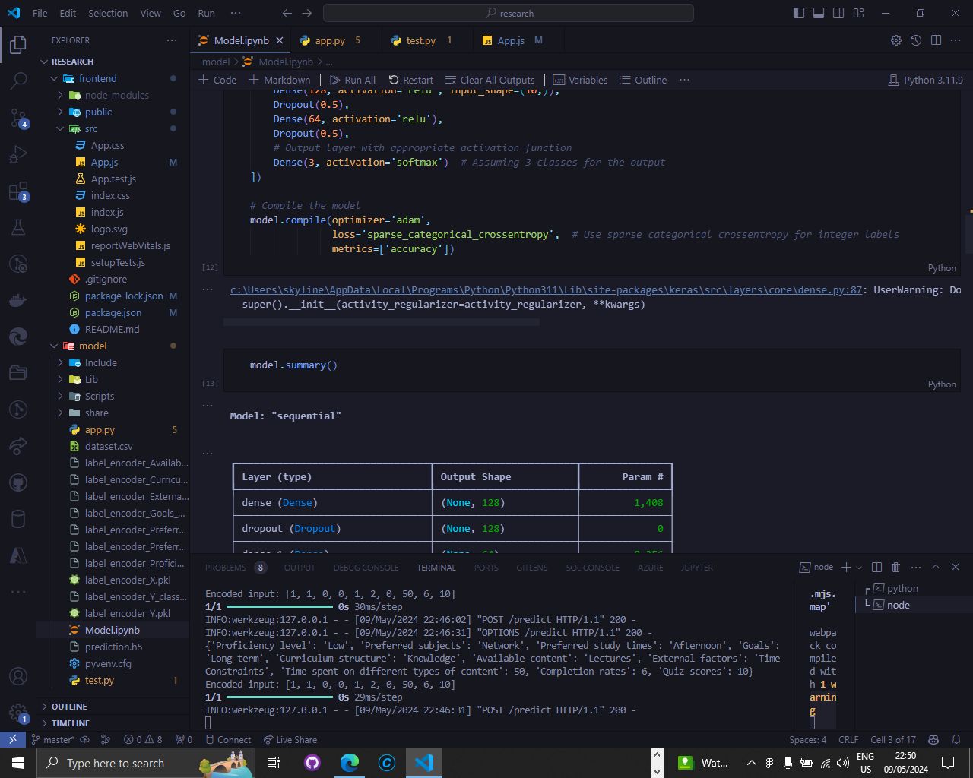
IMPLEMENTATION – PoC
Dynamic Learning pathway generator – Model ( Learning Style )

Slide 36
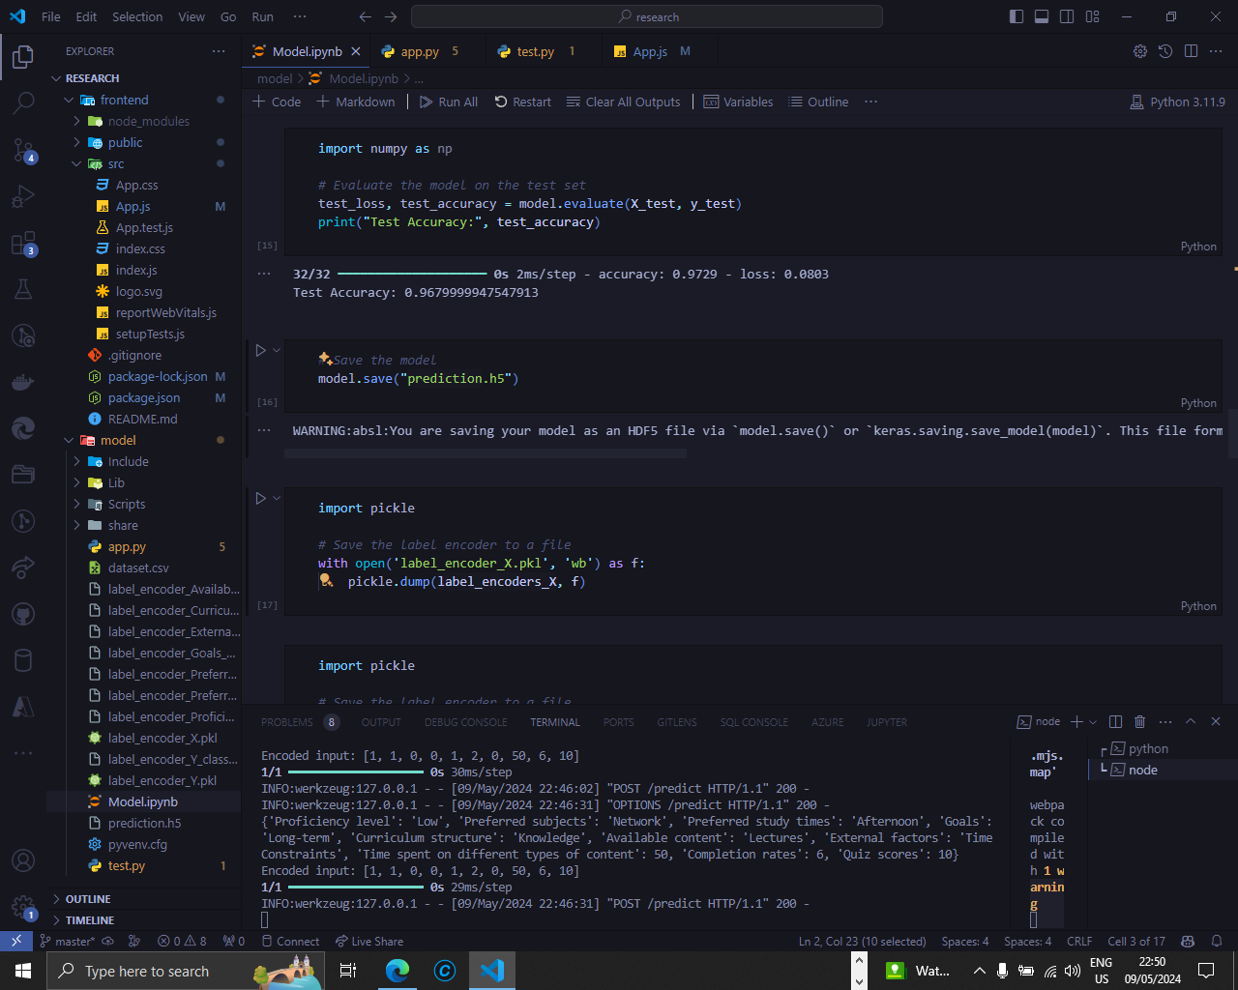
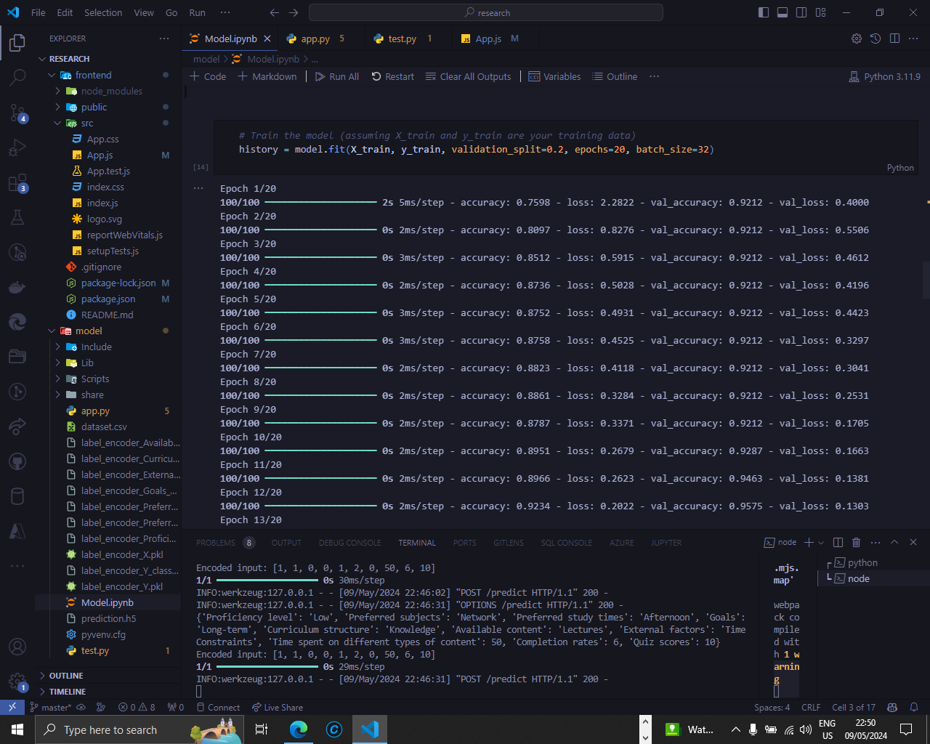
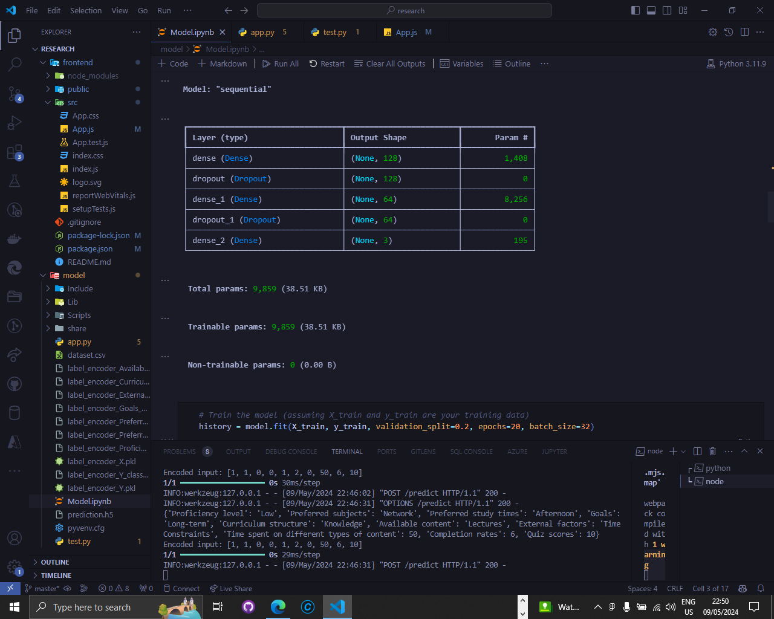
IMPLEMENTATION – PoC
Dynamic Learning pathway generator – Model ( Learning Style )

Slide 37
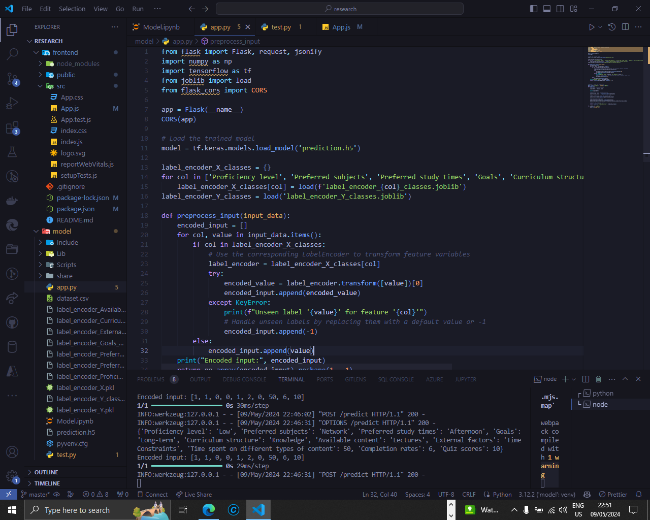
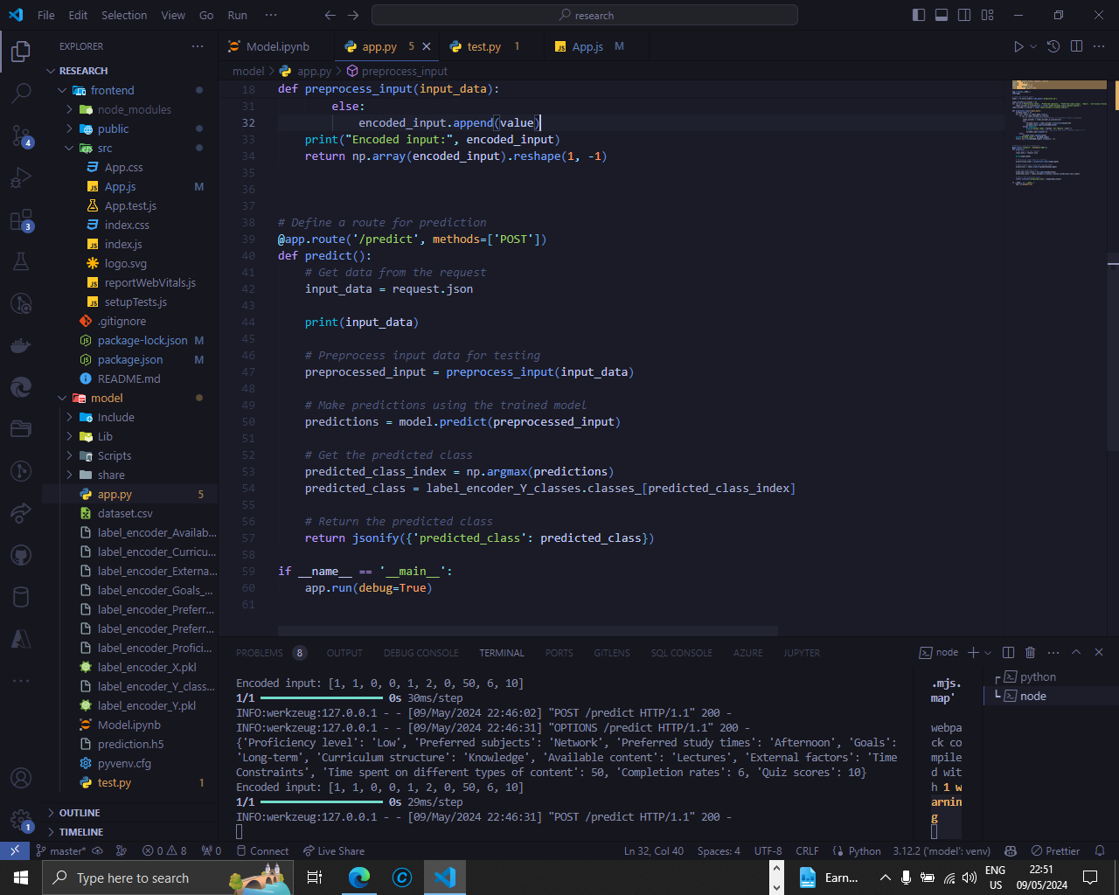
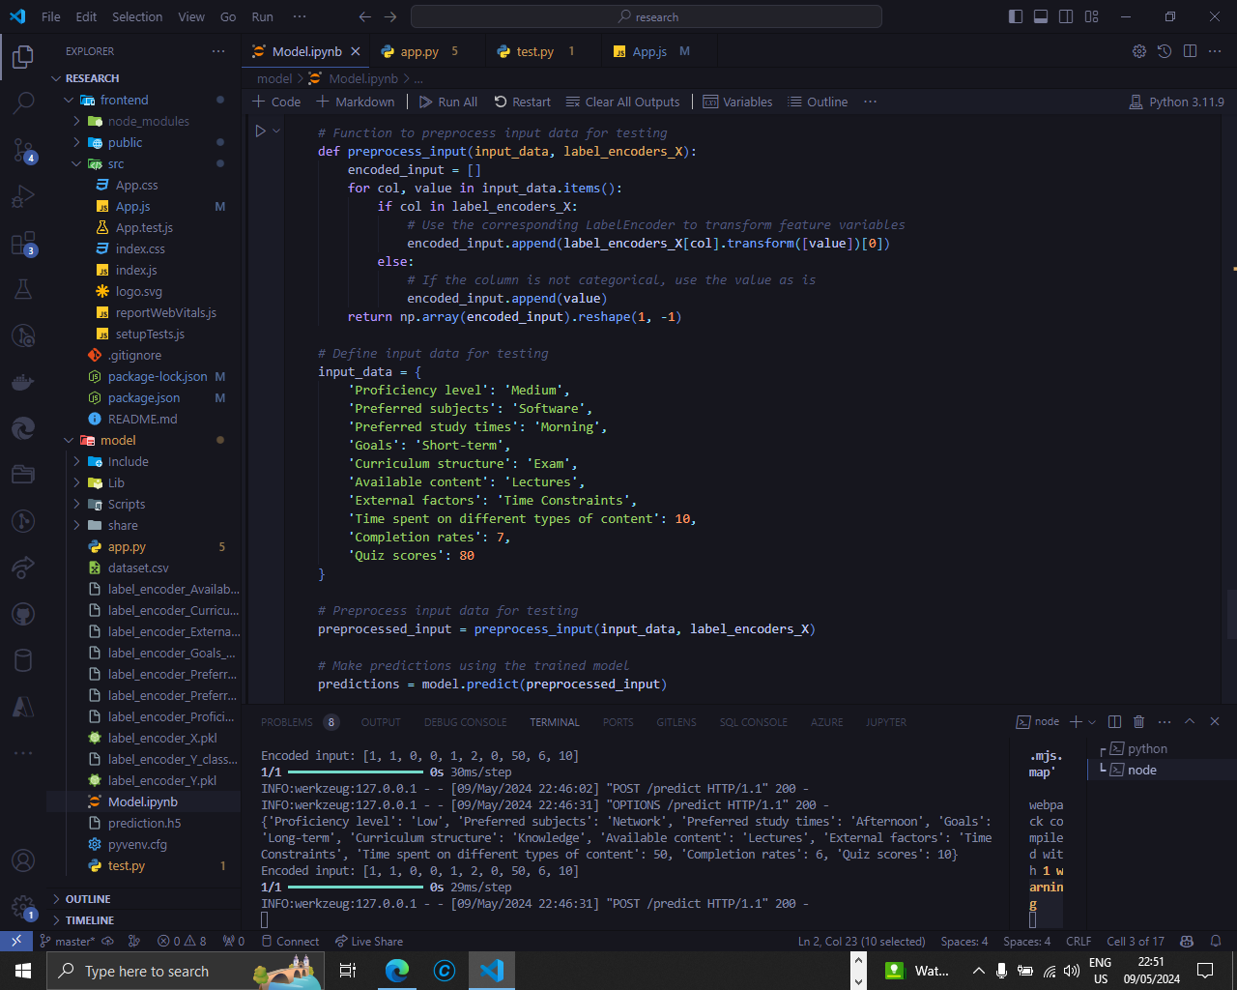
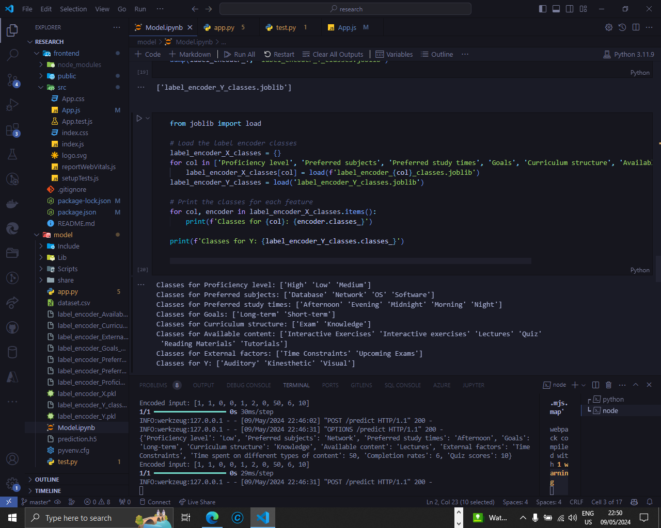
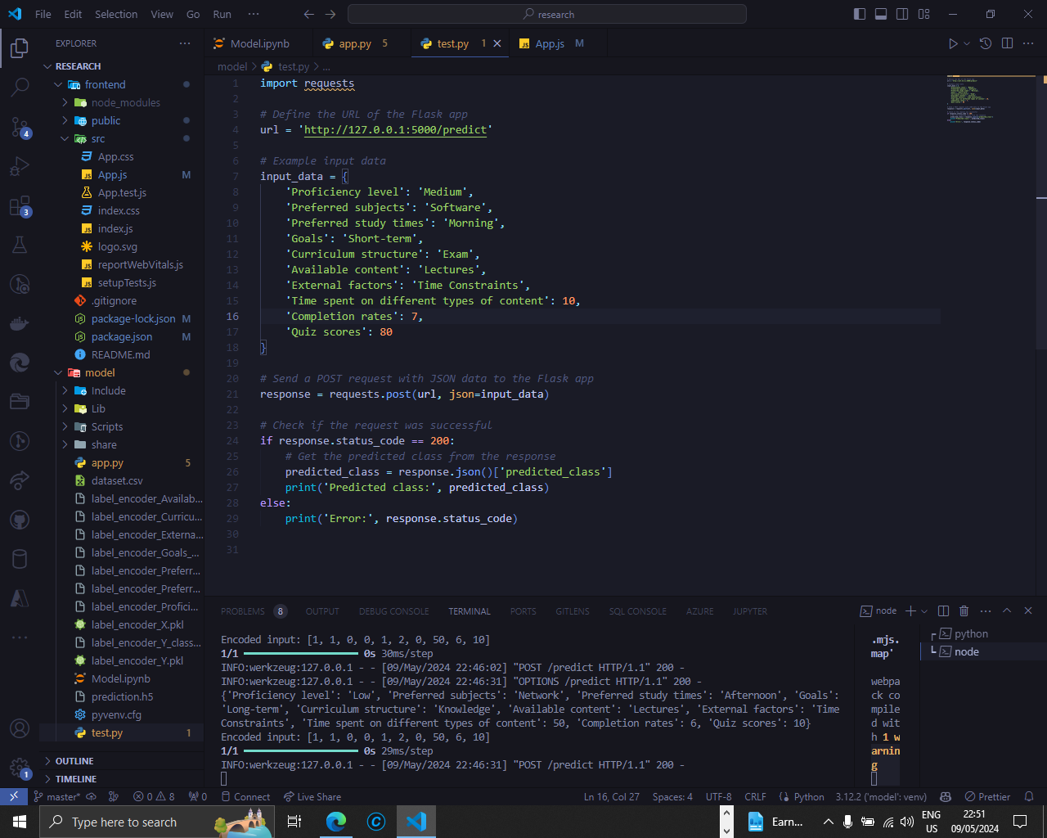
IMPLEMENTATION – PoC
Dynamic Learning pathway generator – Model ( Learning Style )

Slide 38
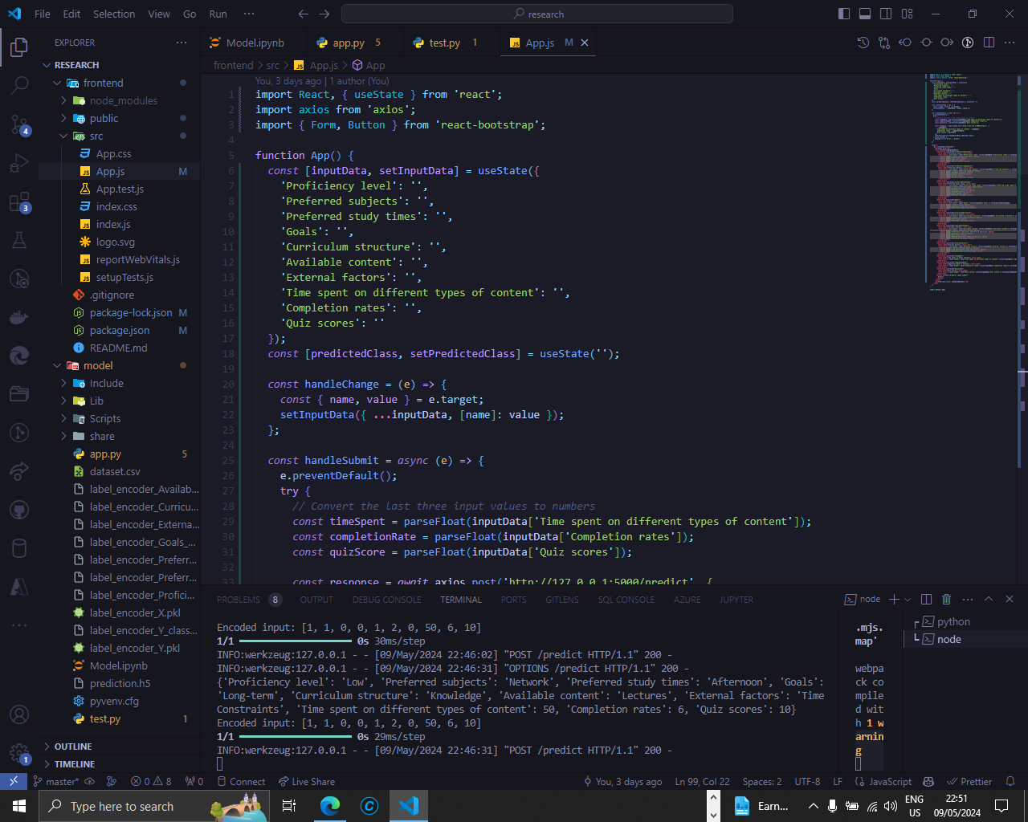
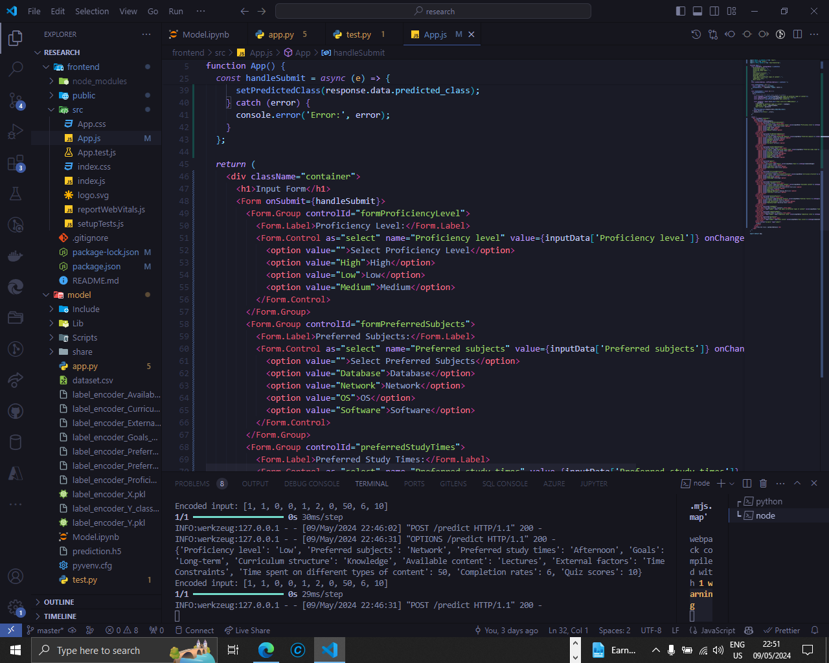
IMPLEMENTATION – PoC
Dynamic Learning pathway generator – Model ( Learning Style ) - FrontEnd

Slide 39
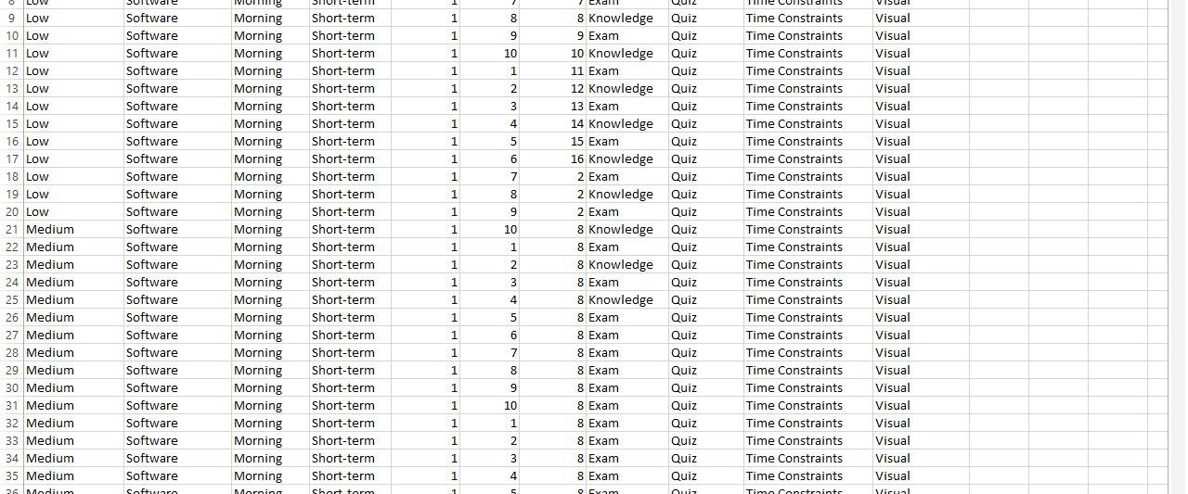
IMPLEMENTATION – PoC
Dynamic Learning pathway generator – Model ( Learning Style ) – Data set

Slide 40
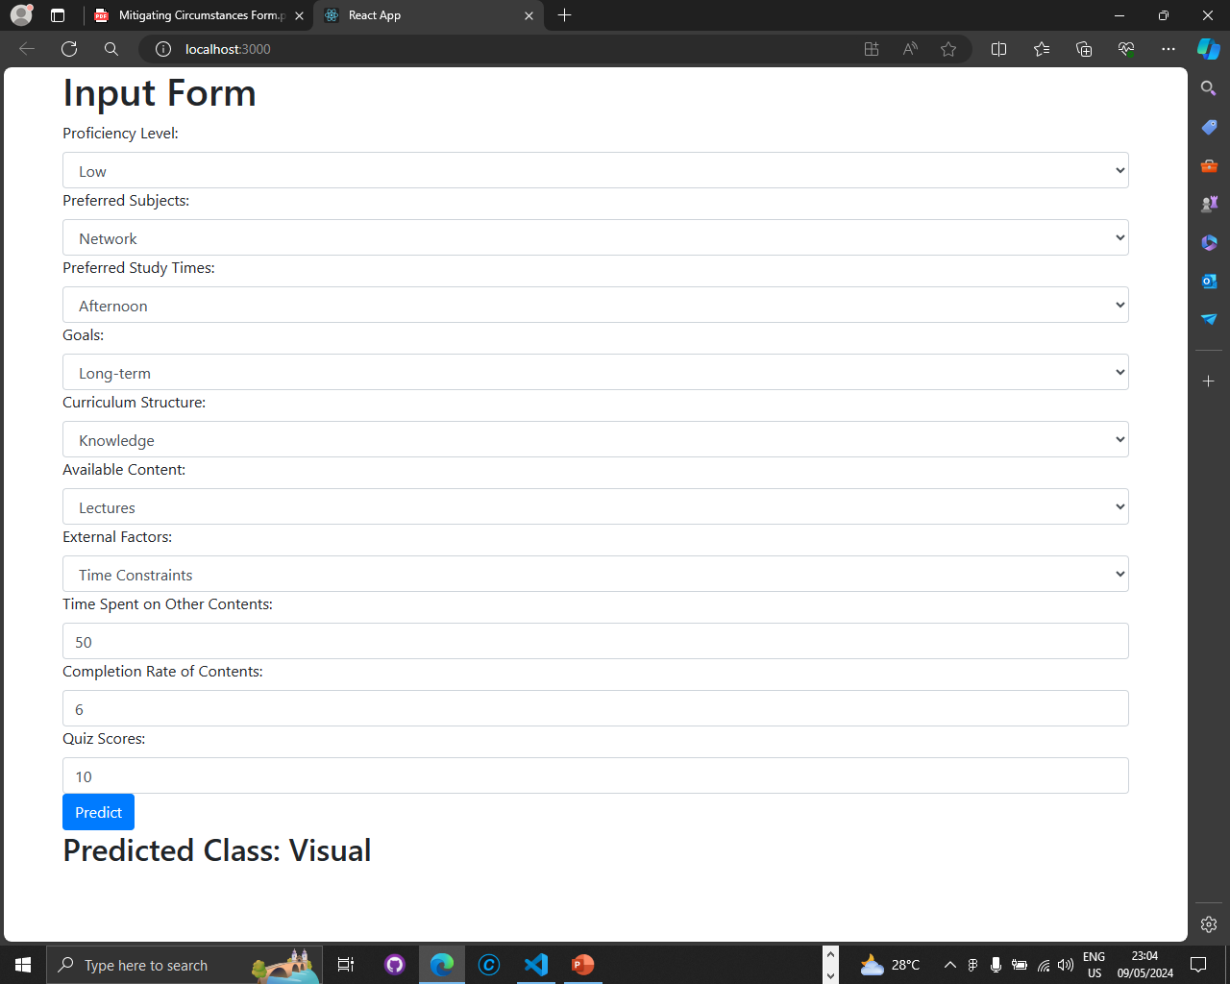
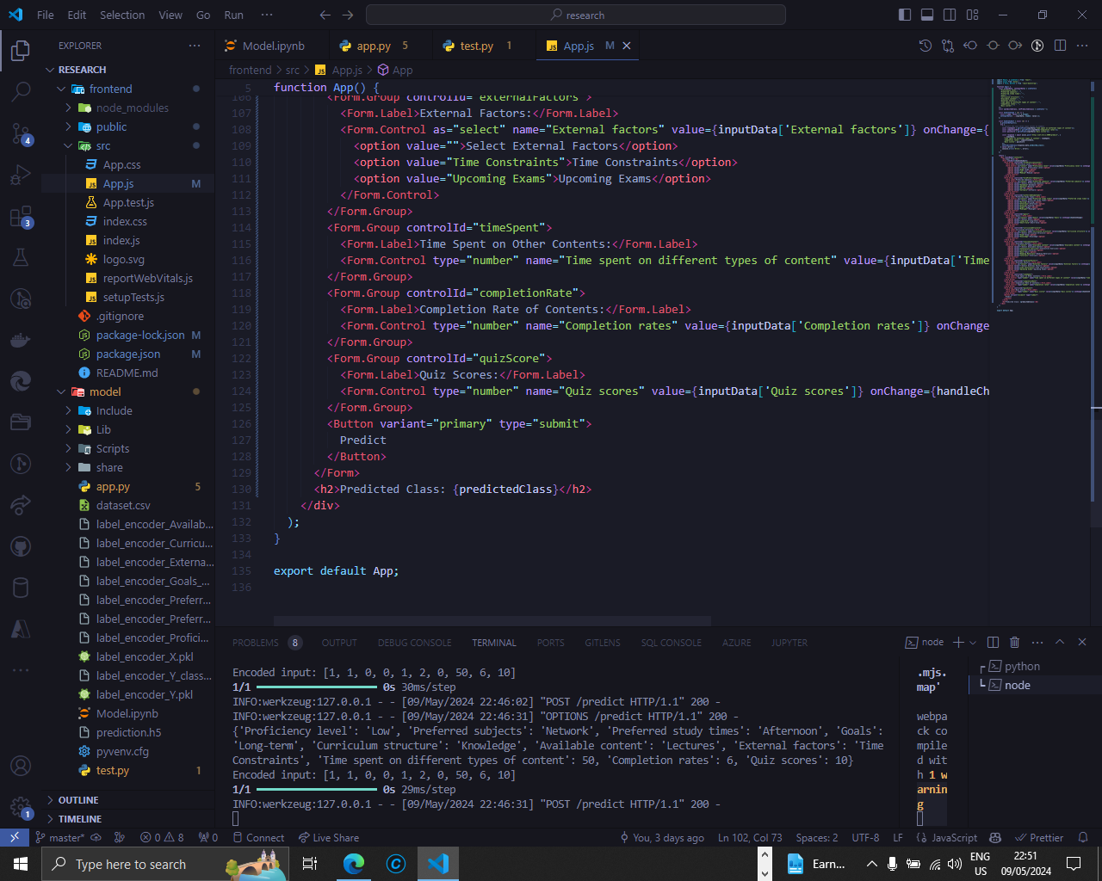
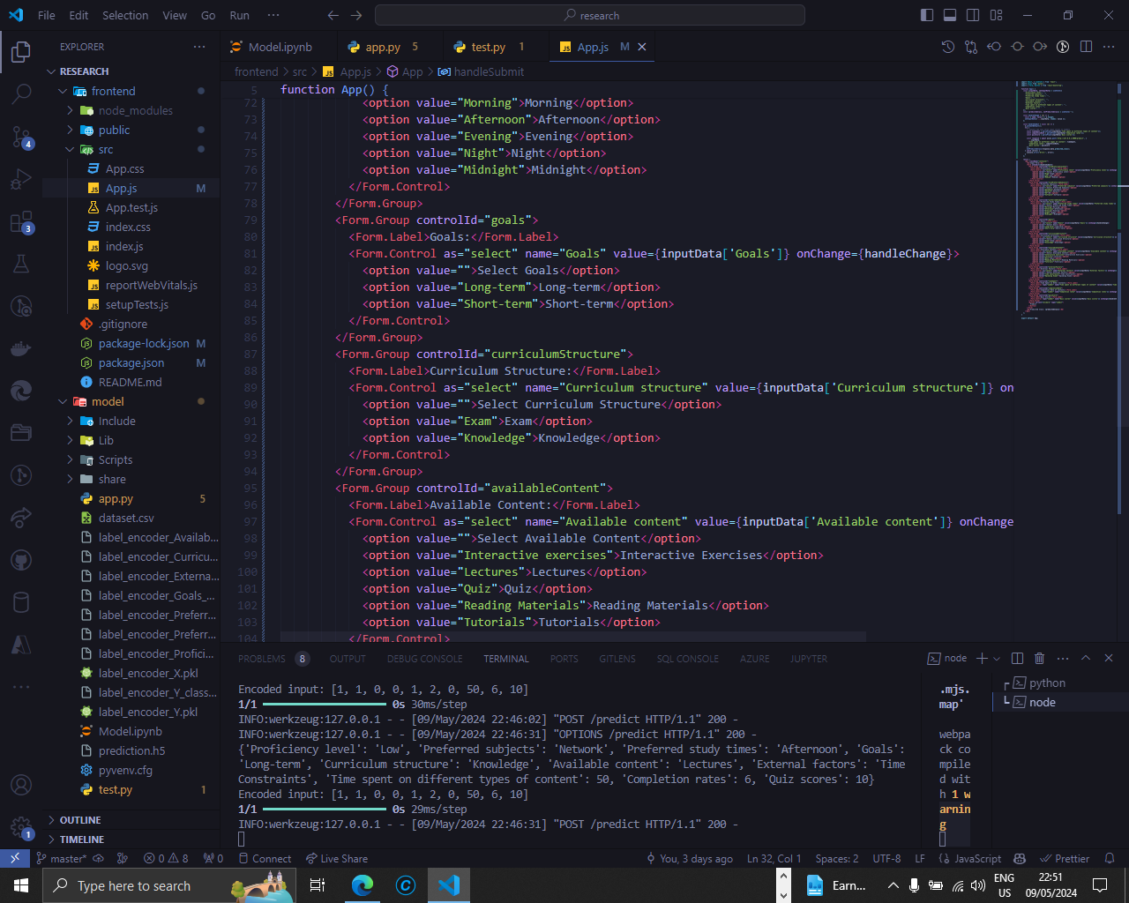
IMPLEMENTATION – PoC
Dynamic Learning pathway generator – Model ( Learning Style ) - FrontEnd

Slide 41
IT21032974 | Nishshanka N.A.G.A.A component 04
Objective : Implementing the dynamic user data gathering module and eye content detection (content focus monitoring), and feedback loop.
Specialization: Information Technology
IT21033032
Nishshanka N.A.P.K.R | R24-112

Slide 42

Component 4: User Interaction & Feedback Loop
Purpose: Continuously improve the system based on user feedback and interaction data.
Lecturer and student feedback collected on content, usability, and performance.
System refinements include simplifying UI, adding advanced resources, and optimizing response times.
Results: Reduced response times by 37%, improved retention rate by 7%, and higher user ratings (from 3.8 to 4.3).

Slide 43
RESEARCH PROBLEM
How effectively can facial expression analysis be utilized to assess user engagement and satisfaction within e-learning environments (content focus monitoring)?
What methodologies can be employed to incorporate non-traditional data, such as eye contact within initial assessments, to assess user attention and inform personalized learning strategies?
How does the incorporation of a feedback loop within engagement analytics influence user satisfaction and perceived learning effectiveness?

Slide 44
SPECIFIC AND SUB OBJECTIVES
Implement a module for analyze the user eye behavior for predict the user focusing level for learning content and integrate a module for summarize the eye monitoring related data and give the weekly report about student focusing for each subjects.
Implement a feedback loop to get each feedback for each of learning material suggested from the system and Ingenerate OpenAI or Gemini Ai for list down the learning material according to best feedback to bad feedback.
Implement a python module for analysis the feedback loop output and remove learning material from system which get worse feedbacks.
Implementing the MySQL database configuration related to the component.
Implementing the all-relevant frontend pages related to the component.

Slide 45
User Interaction & Feedback Loop : Component Diagram

Slide 46
COMPLETED TASKS
Complete background research about other LMS platforms and their data usage.
Implement a simple python code for eye detection.
Partially implement a webpages related to the component.
Research terms about the eye detection (technologies, past developments)
Research about OpenAI and Gemini Ai integration for feedback loop.
Identify and finalize the technology stack and backend configurations and database configurations for overall system.
Learn about the relate technologies (system engineering terms) for how to setup this kind of system in real world.
Implement a module for analyze the user eye behavior for predict the user focusing level for learning content.
Implement a feedback loop to get each feedback for each of learning material suggested from the system.
Ingenerate OpenAi or Gemeni Ai for list down the learning material according to best feedback to bad feedback.
Implementing the MySQL database configuration related to the user profiling part.

Slide 47
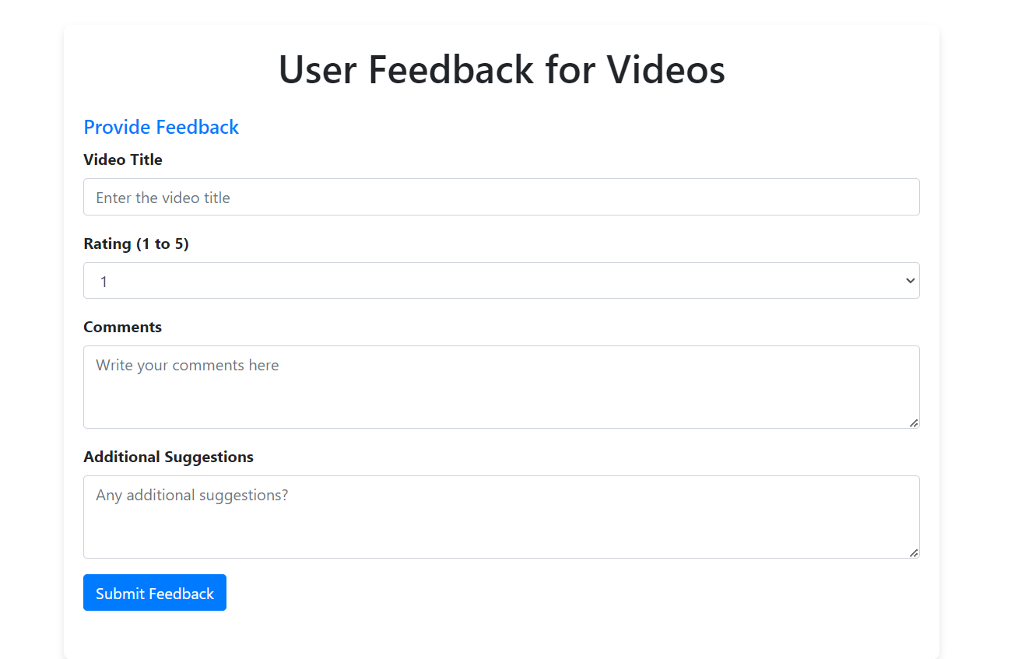
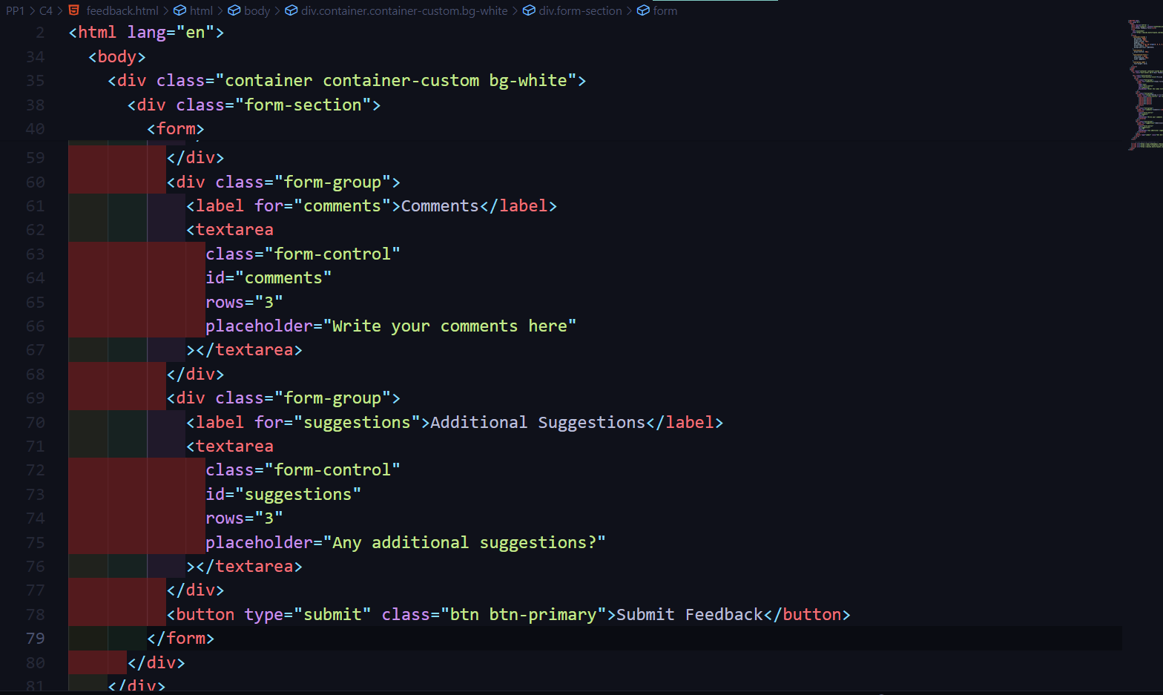
IMPLEMENTATION – PoC
User feedback form

Slide 48
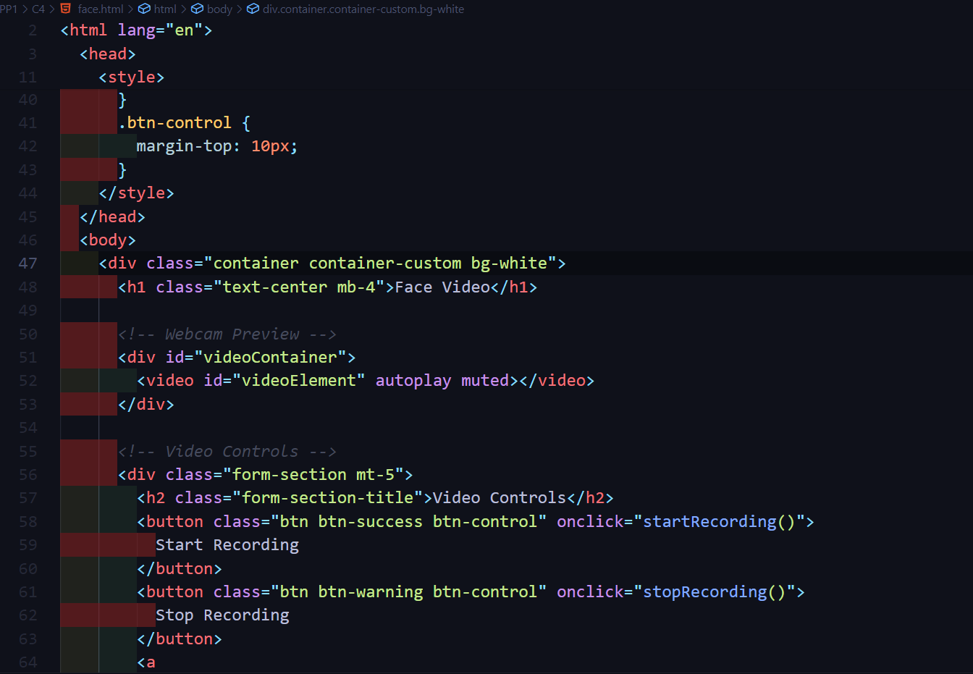
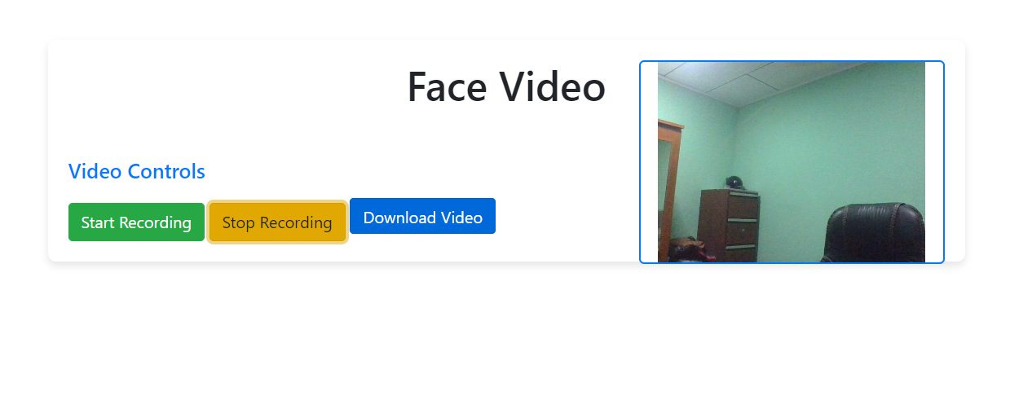
IMPLEMENTATION – PoC
Initial Data gathering form

Slide 49
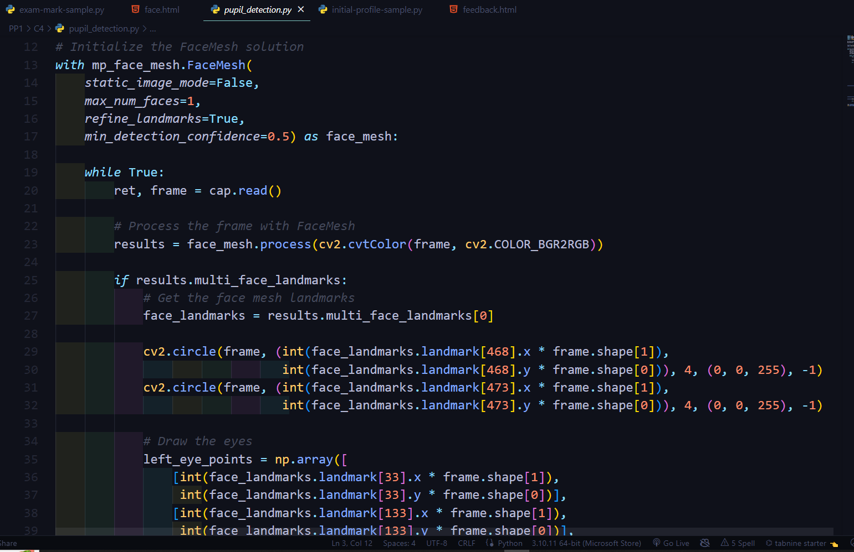
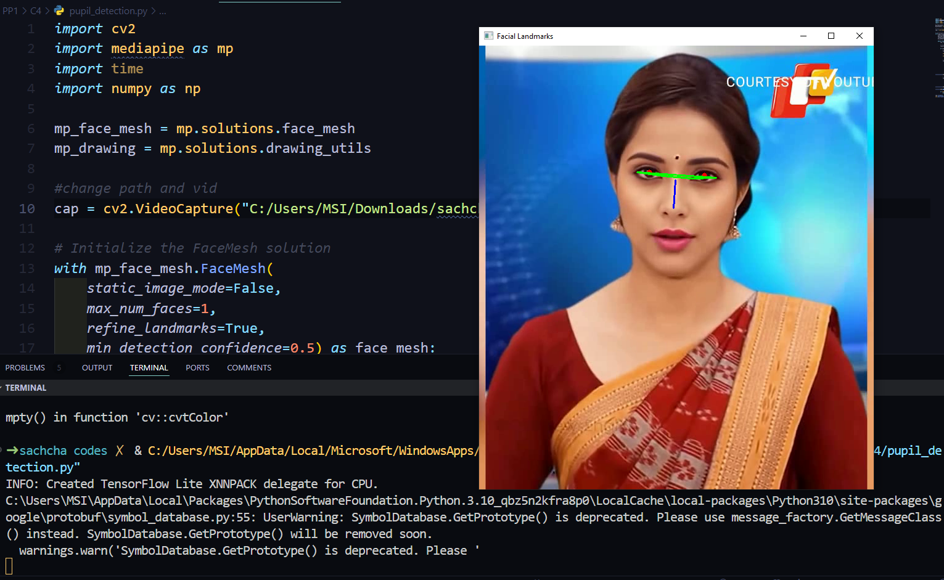
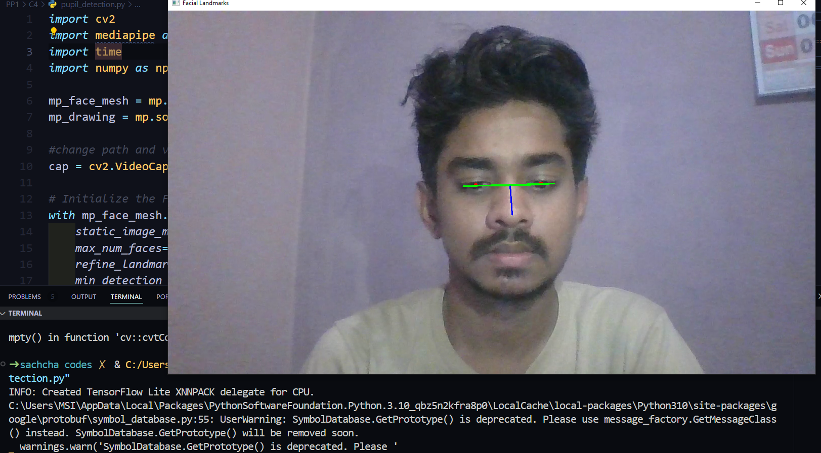
IMPLEMENTATION – PoC
Eye detection python code

Slide 50

Results
Student engagement: 35% increase in interactions and 28% improvement in knowledge retention.
User satisfaction: Over 90% of users reported enhanced learning experiences.
Self-assessment scores: 22% higher for LearnPath+ users compared to traditional systems.

Slide 51
Conclusion
LearnPath+ offers a personalized, adaptive learning experience tailored to individual needs.
1
Machine learning algorithms ensure dynamic content delivery and real-time personalization.
2
Future work includes scaling the system to other educational fields and enhancing adaptive algorithms.
3

Slide 52
Acknowledgements
Special thanks to:
Mr. Sanjeevi Chandrasiri (Senior Lecturer, SLIIT)
Ms. Akshi De Silva (Lecturer, SLIIT)
Mr. Harshana Samaranayake (Associate Technical Lead, Tiqri)
Mr. J. W. P. Nuwan Deshapriya (Senior Site Reliability Engineer)

Slide 53

Thank you..!
Q & A

